Slide 1
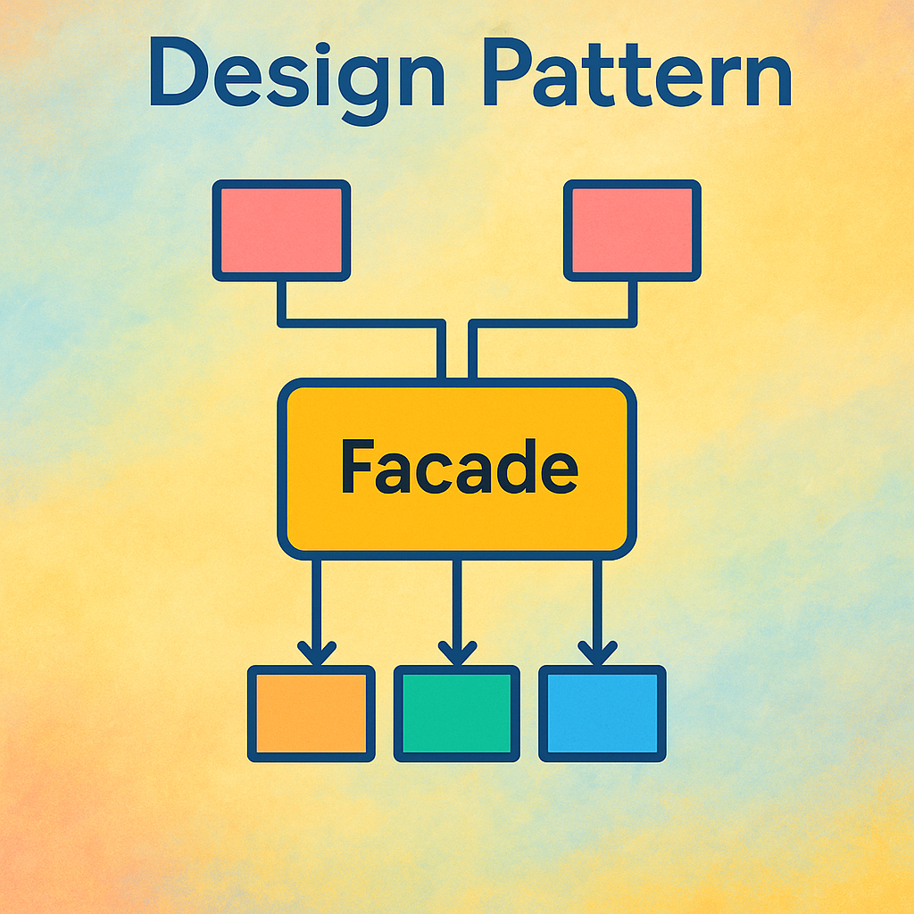

Slide 2
Creational (5)
Factory
Structural (7)
Adapter
Behavioral (11)
Chain Of Responsibility
Abstract Factory
Singleton
Prototype
Builder
Bridge
Composite
Decorator
Facade
Flyweight
Proxy
Command
Interpreter
Iterator
Mediator
Memento
Observer
State
Strategy
Template
Visitor

Slide 3
OOP Principals
Class
Object
Constructors
Inheritance
Method Overriding
Encapsulation
Interfaces
Abstractions
Polymorphism

Slide 4

What is FAÇADE?
​the front of a building.
the way that somebody/something appears to be, which is different from the way somebody/something really is.

Slide 5


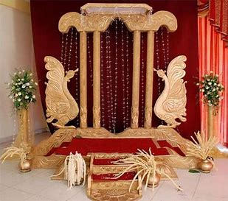

How do you organize a wedding

Slide 6
FACADE Design Pattern
Provide a unified interface to a set of interfaces in a subsystem.
Facade defines a higher-level interface that makes the subsystem easier to use.
Structural type design pattern
Wrapper class that encapsulates a subsystem in order to hide subsystem’s complexity.
Can be used in complex systems that have multiple and different sub systems..
Reduce dependencies of outside code on the inner workings of a library.

Slide 7


Think about a waiter

Slide 8
Facade design pattern does NOT add any functionality. We should try to avoid add any functionally to the interface.
Facade design pattern is point of entry into system / sub system.
Facade is a wrapper class that encapsulates a subsystem in order to hide the sub system complexity.
It interfaces multiple classes to interact.
User should have the option of directly connect to the subsystems if needed without the interface.

Slide 9
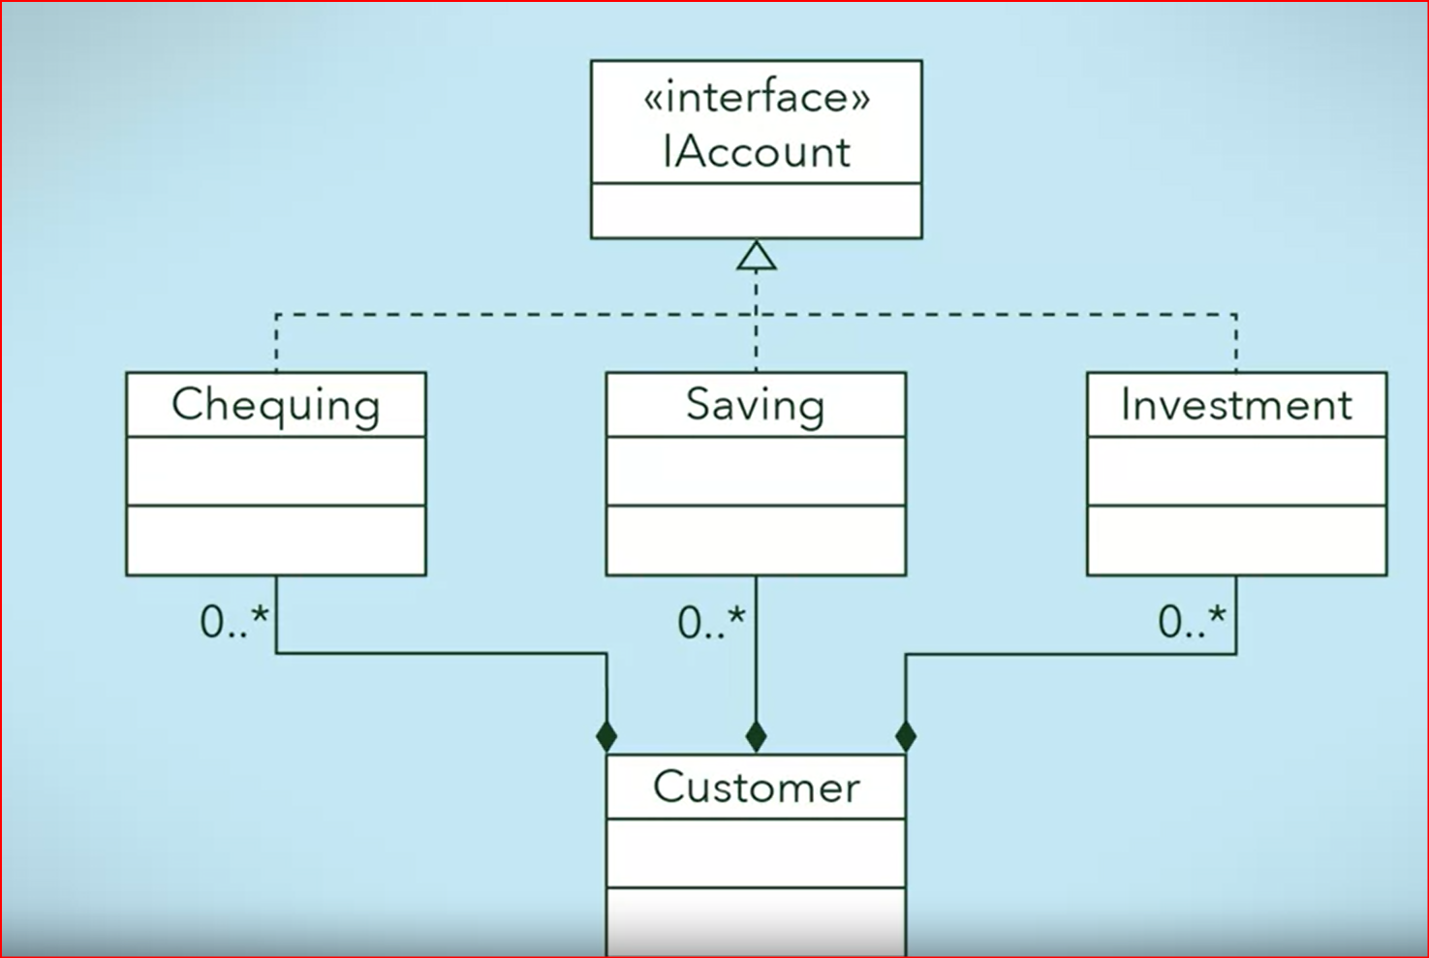
Implementation without FACADE

Slide 10
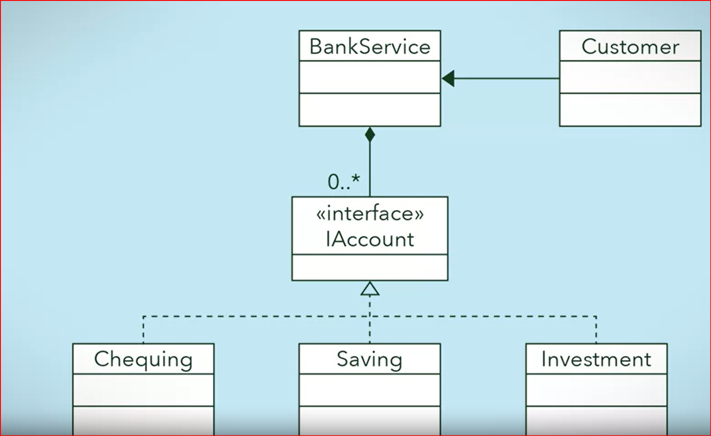
Implementation with FACADE

Slide 11
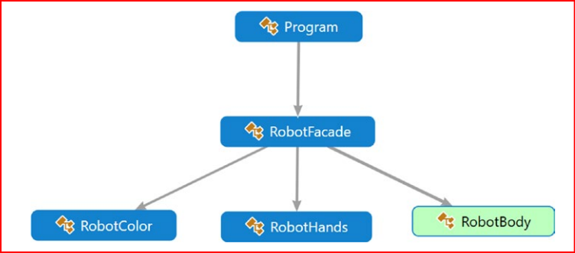
Refer 116 - 120

Slide 12
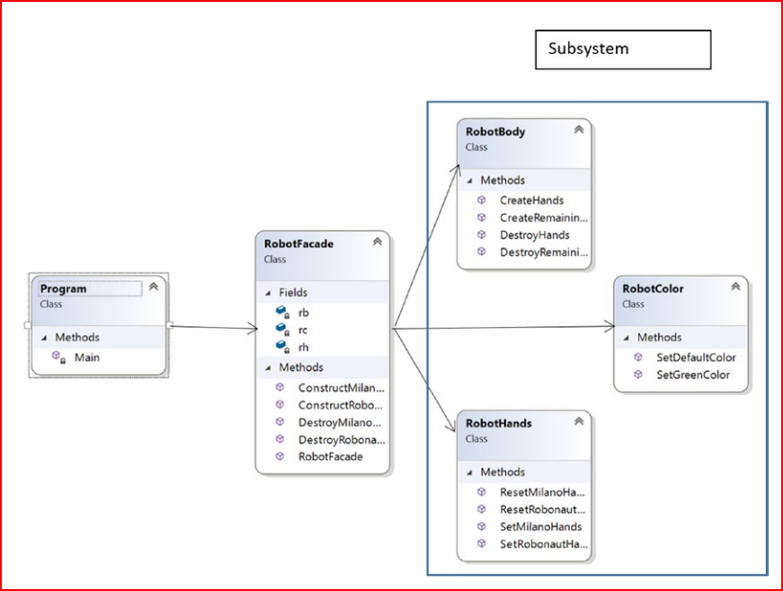

Slide 13
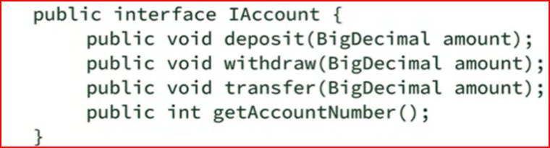
Step 1: Design the interface

Slide 14
What is an interface class?
A Java interface is a bit like a class, except a Java interface can only contain method signatures and fields.
Interfaces will define the specifications for Classes that govern how code will behave.
An Java interface cannot contain an implementation of the methods, only the signature (name, parameters and exceptions) of the method.
In interface, variables can be defined only as constants.
interface A{
void m();
int x=0;
}

Slide 15
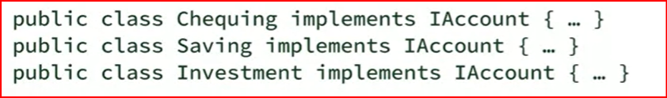
Step 2: Implement the interface with one or more classes

Slide 16
Step 3: Create the facade class and wrap the classes that implements the interface

Slide 17
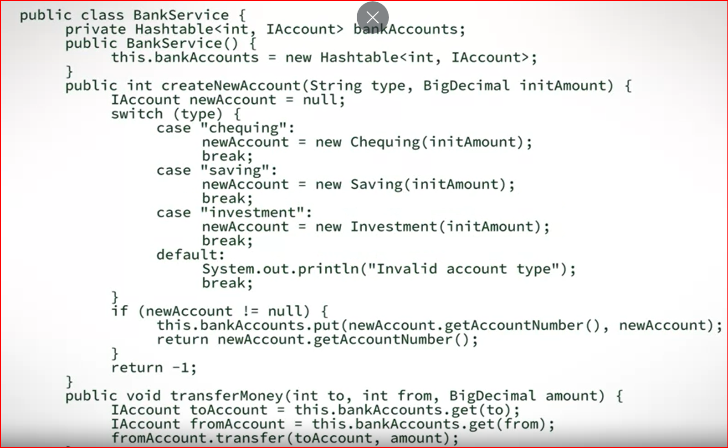

Slide 18
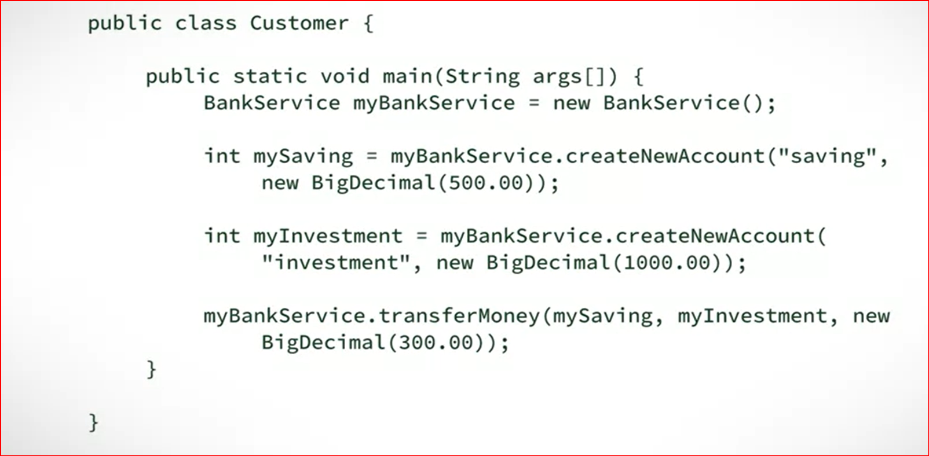

Slide 19
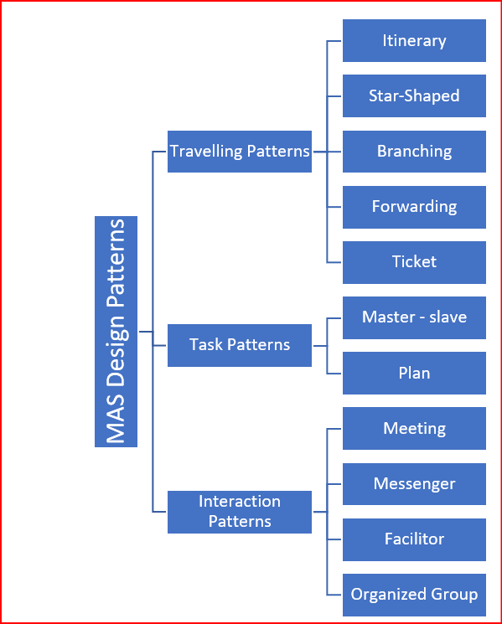
Extension of Facade Design Patterns-Multi Agents

Slide 20
Facade Design Pattern
Use to hide the complexity of a subsystem by encapsulating it behind a unified wrapper class called a facade class.
Removes the need for client classes to manage a subsystem on their own
Handles instantiation and redirection of tasks to appropriate class within the subsystem.
Provides client classes with a simplified interface for the subsystem.
Acts simply as a point of entry to a substem and does not add more functional to the subsystem.

Slide 21
Q&A
What are the key advantages of using the Facade pattern?
Can you access each of the subsystems directly?
There should be only one facade for a complex subsystem. Is this understanding correct?
What are the challenges associated with the Facade pattern?

Slide 22
How FAÇADE Design Pattern Can Be Used in Your Projects?

